Slide 1
Basal Eudicots
Judd et al pp. 323-334

Slide 2
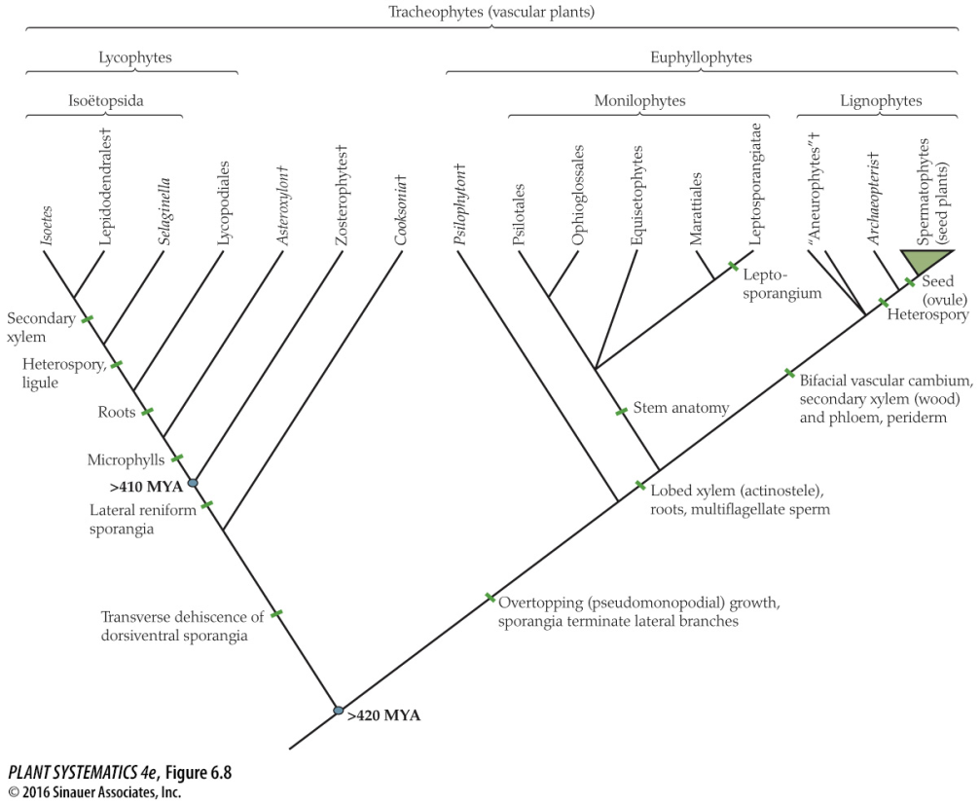
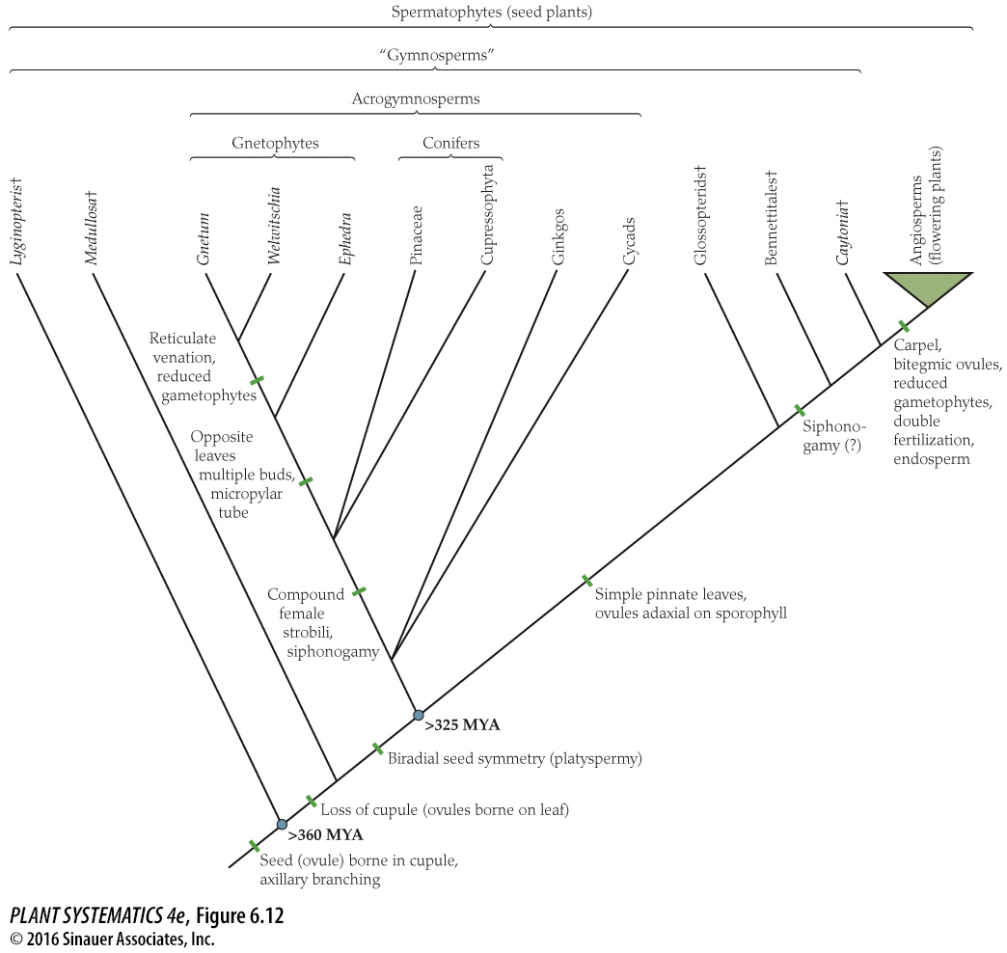
Remember the really big picture…
Mosses, Liverworts, Hornworts
Algae

Slide 3
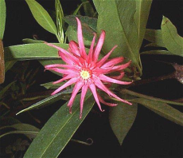
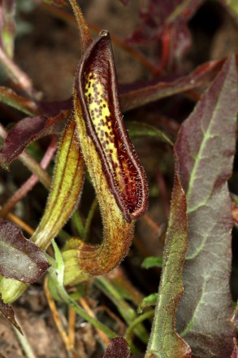
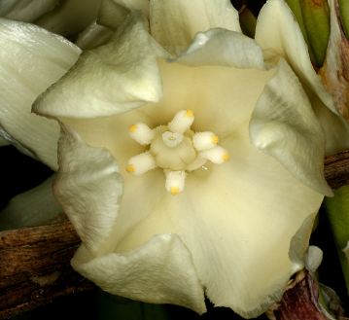
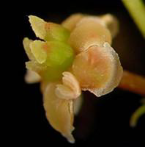
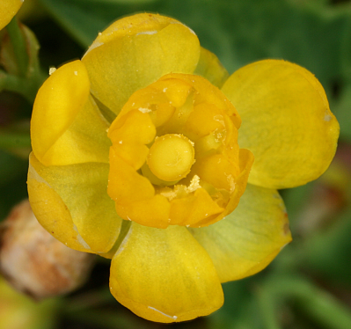
Magnoliids
Amborella
Nymphaeales
Austrobaileyales
Monocots
Eudicots
ANA Grade
Remember the big picture….
You are here
Angiosperm Relationships
(simplified)

Slide 4
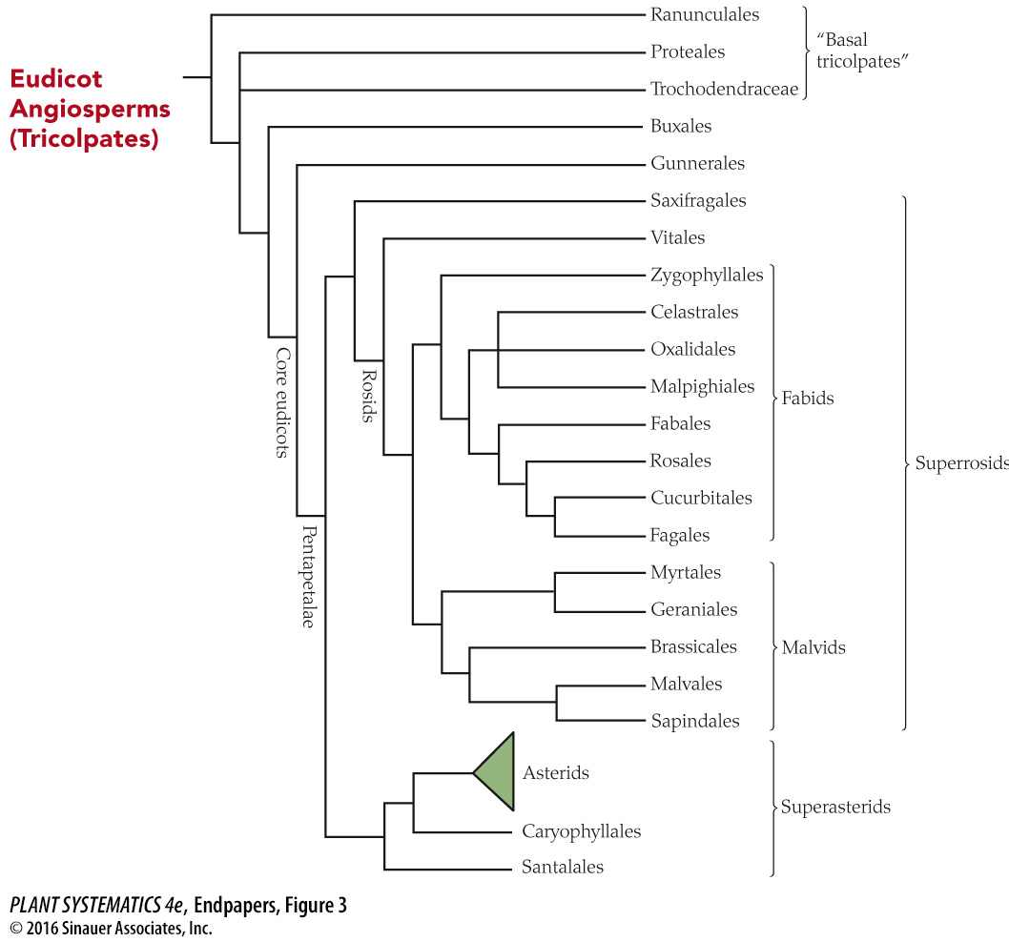
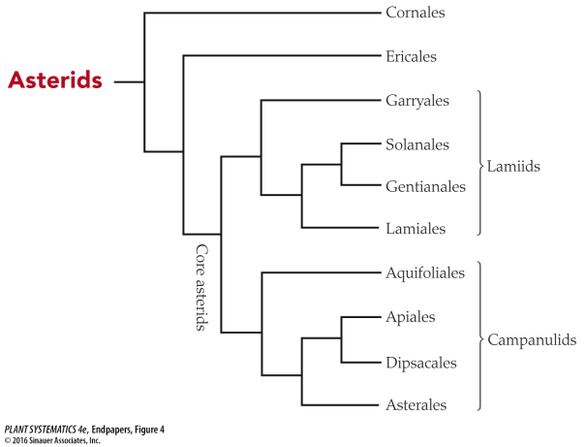
Santalales
Caryophyllales
Superasterids

Slide 5
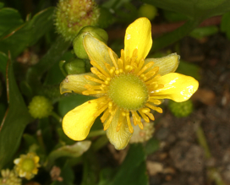
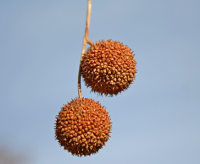
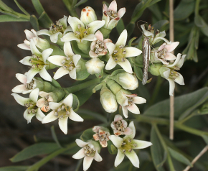
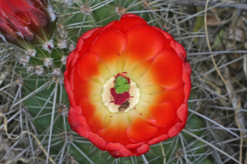
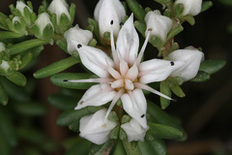
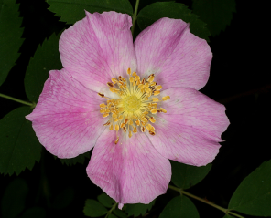
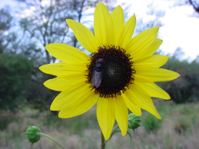
Proteales
Santalales
Ranunculales
Saxifragales
Caryophyllales
Rosids
Asterids
= Fabids + Malvids
= Lamiids + Campanuliids (+ Ericales + Cornales)
Core Eudicots
Basal Eudicots
Simplified Eudicot Phylogeny (Eudicot= Tricolpate)

Slide 6
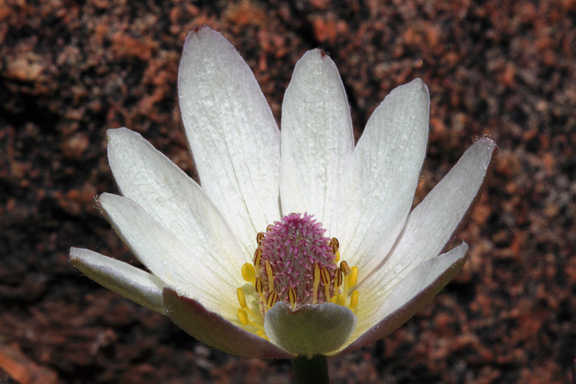
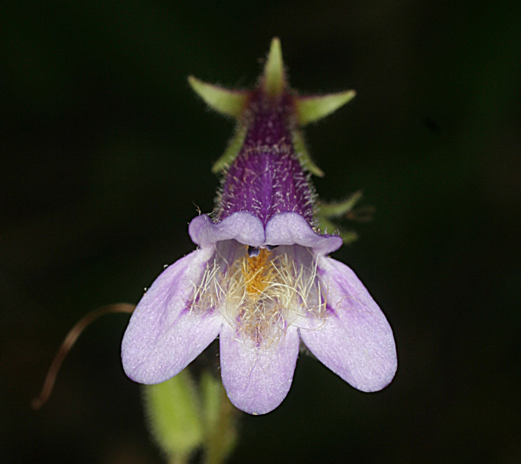
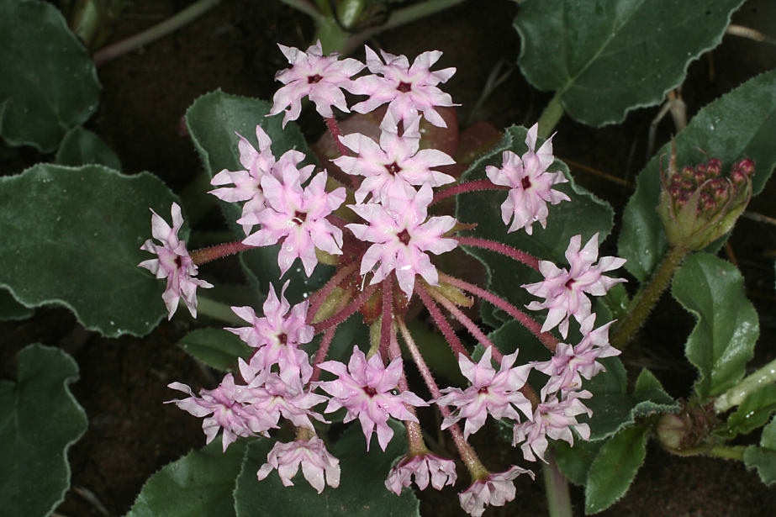
Eudicots: about 190,000 species-- 75% of all Angiosperms
Anemone tuberosa
Penstemon metcalfei
Ranunculus cymbalaria
Tripterocalyx carneus
Castilleja integra

Slide 7
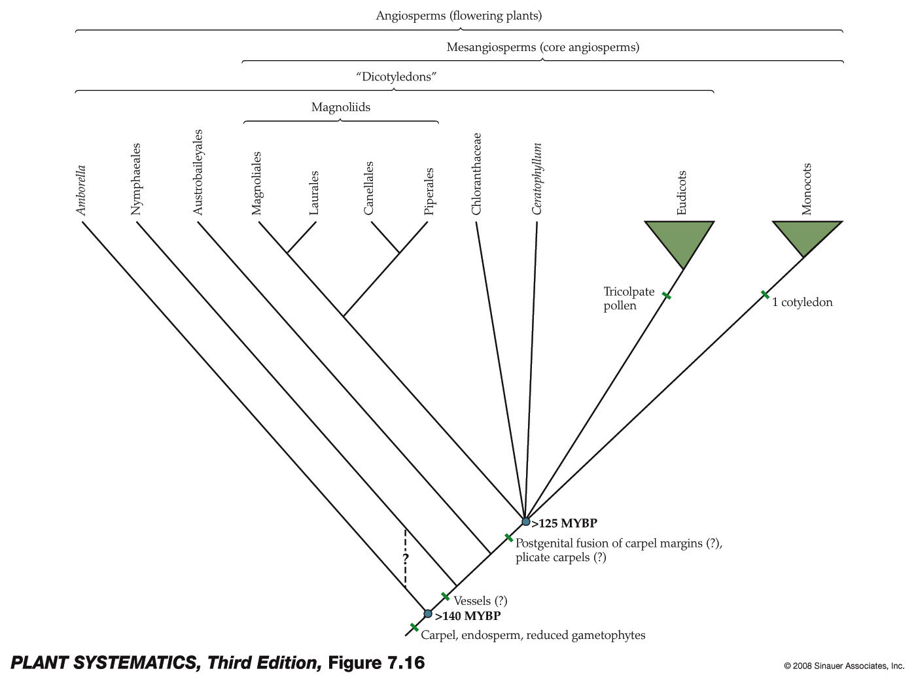

Slide 8
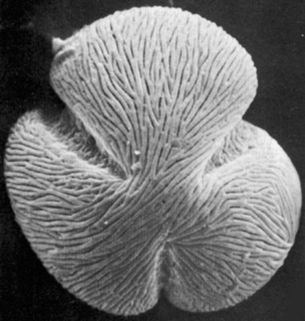
Eudicot Synapomorphy (also known as “tricolpates” for a reason!)
(DNA Sequence characters are also synapomorphies for eudicots)
Tricolpate means their pollen grains have three furrows

Slide 9
A Mess of Terms…all mean almost the same
Tricolpate= Trisulcate= pollen grain with three long grooved apertures
Triporate= pollen grain with three equatorial, porelike apertures
Tricolporate= pollen grain with three long, grooved apertures, each with a central pore
Polyporate– pollen grain with many porelike apertures. Generally if pollen is polyporate, it is assumed to be derived from a triporate pollen type (can also be polycolpate, polycolporate, polysulcate…)

Slide 10
Pollen Apertures
A&C are monocots/magnoliids, all the rest are eudicots

Slide 11
Eudicots: Other Recognition Characters (but probably plesiomorphic– mostly helpful in telling monocot from eudicot)
Two cotyledons
These characters and those in the following slides may also occur occasionally in Magnoliids, Pinaceae, etc.
Taproot

Slide 12
Eudicots: Other Recognition Characters (but probably plesiomorphic– mostly helpful in telling monocot from eudicot)
Reticulate venation

Slide 13
Eudicots: Other Recognition Characters (but probably plesiomorphic– mostly helpful in telling monocot from eudicot)
Flower parts in 4s or 5s rather than 3’s.

Slide 14
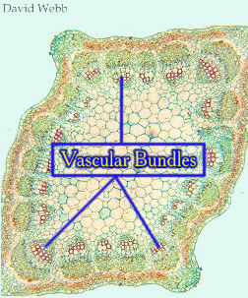
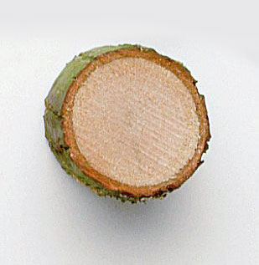
Eudicots: Other Recognition Characters
(but probably plesiomorphic– mostly helpful in
telling monocot from eudicot)
(sometimes)
11

Slide 15
Santalales
Caryophyllales
Superasterids

Slide 16
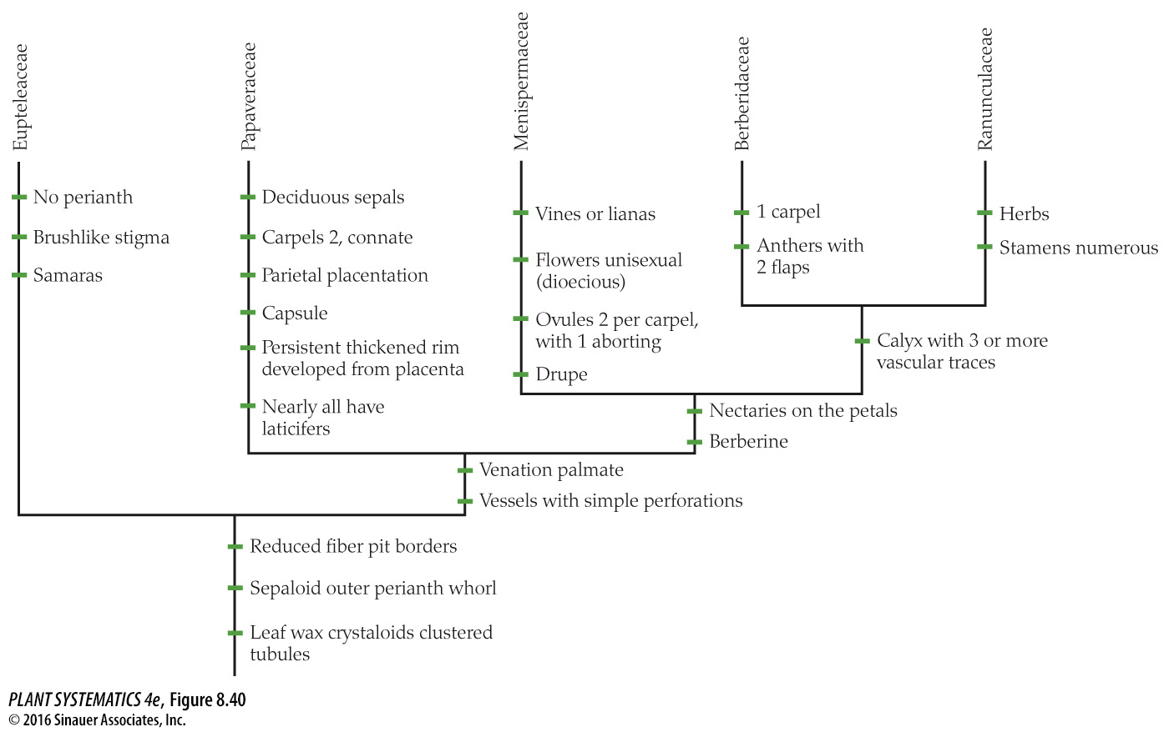
Not well supported morphologically, but well supported by rbcL, atpB, 18S sequences
Ranunculales

Slide 17
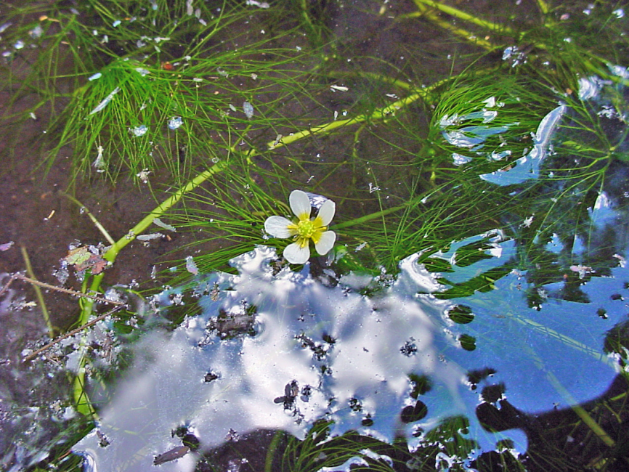
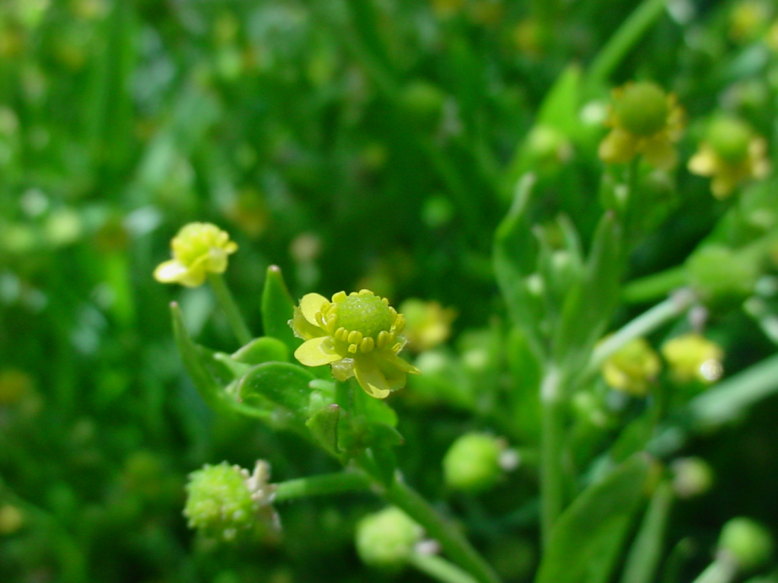
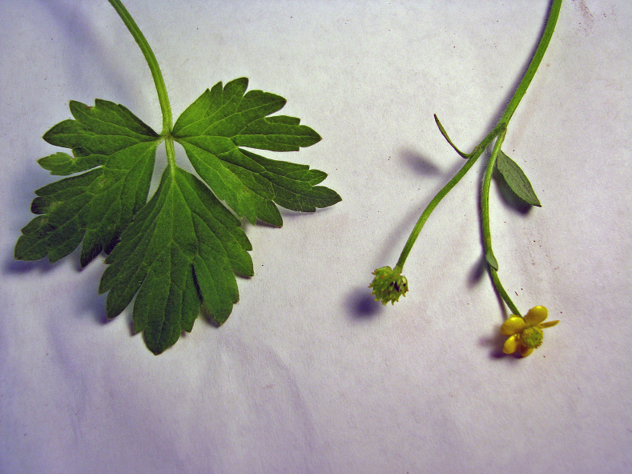
Ranunculales: Ranunculaceae: Ranunculus
R. scleratus
R. aquatilis
R. cymbalaria
Ranunculus pensylvanicus

Slide 18
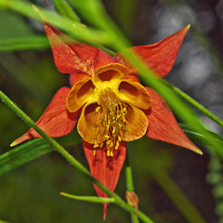
Ranunculales: Ranunculaceae
Anemone tuberosa
Aquilegia desertorum

Slide 19
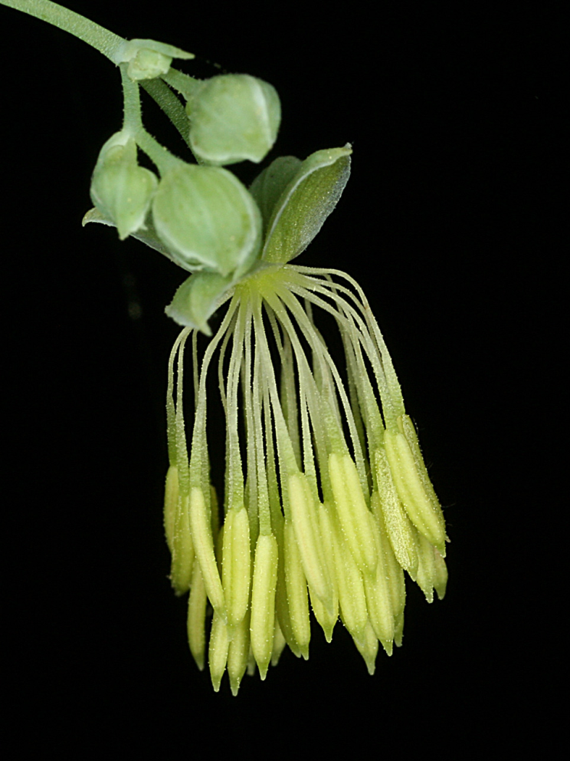
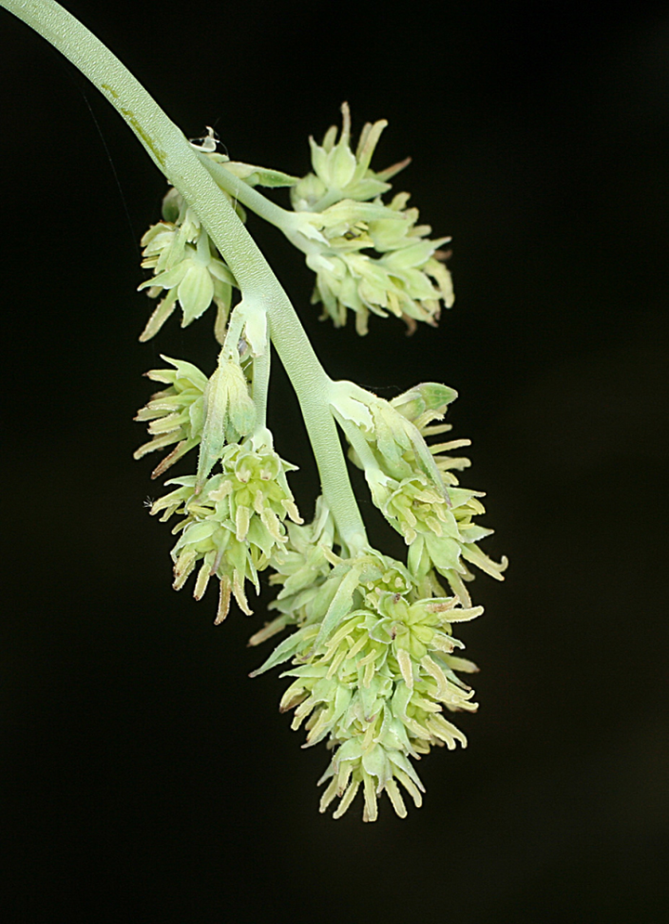
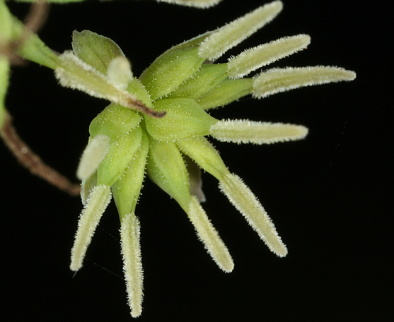
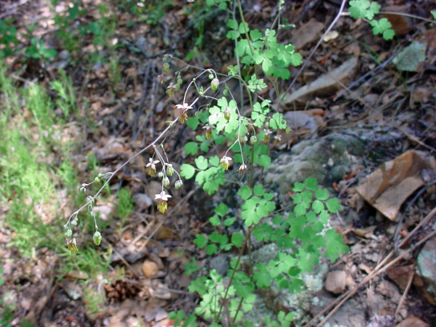
Ranunculales: Ranunculaceae (usually but not always bisexual flowers!)
Thalictrum fendleri (staminate)
Thalictrum fendleri (carpellate)

Slide 20
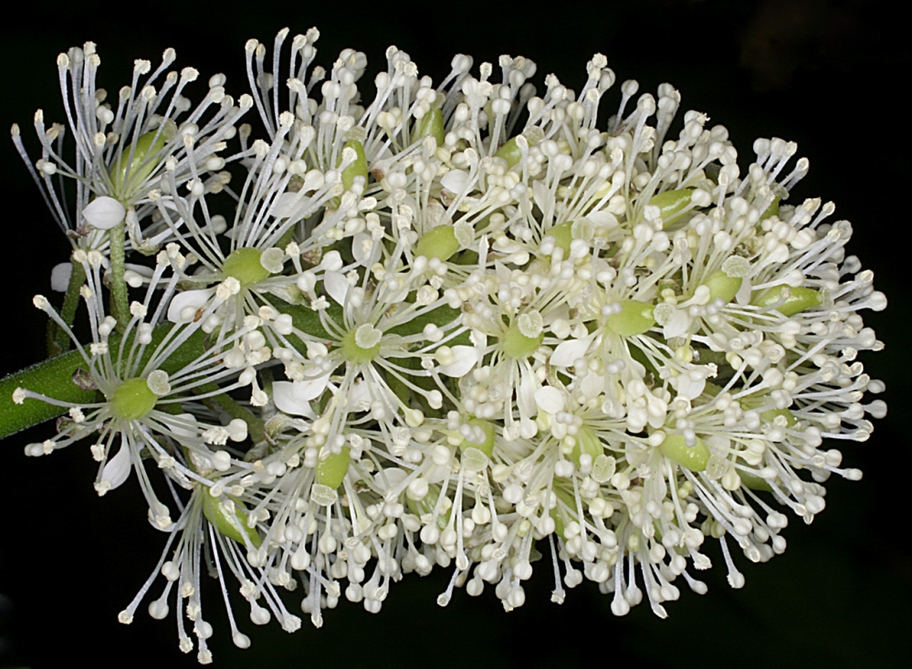
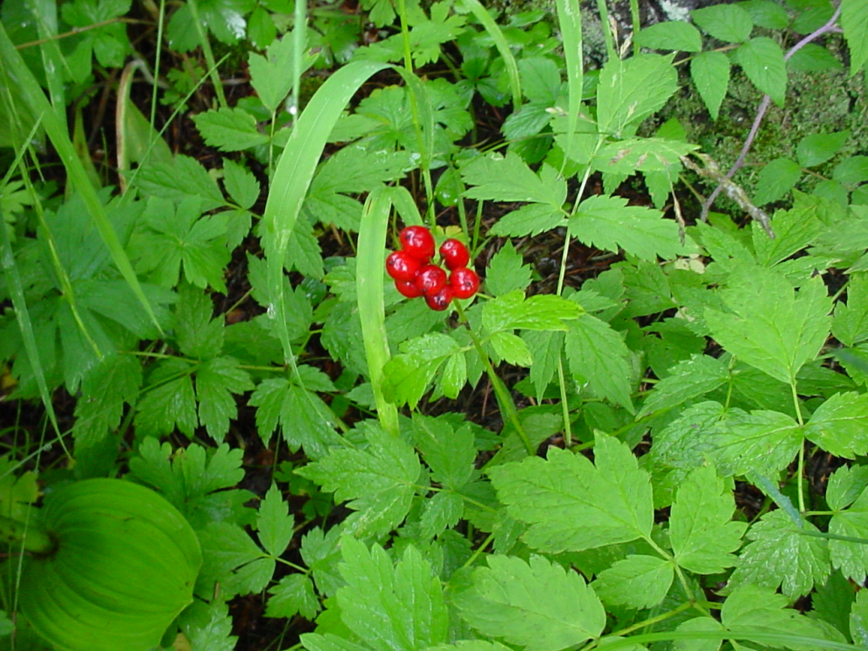
Ranunculales: Ranunculaceae
Actaea rubra
Actaea rubra
Bisexual flowers

Slide 21
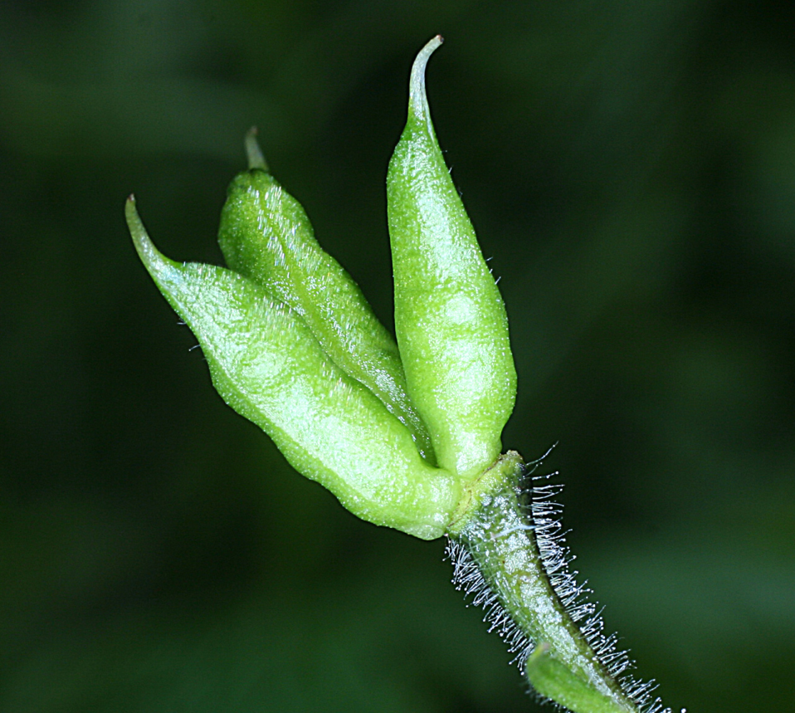
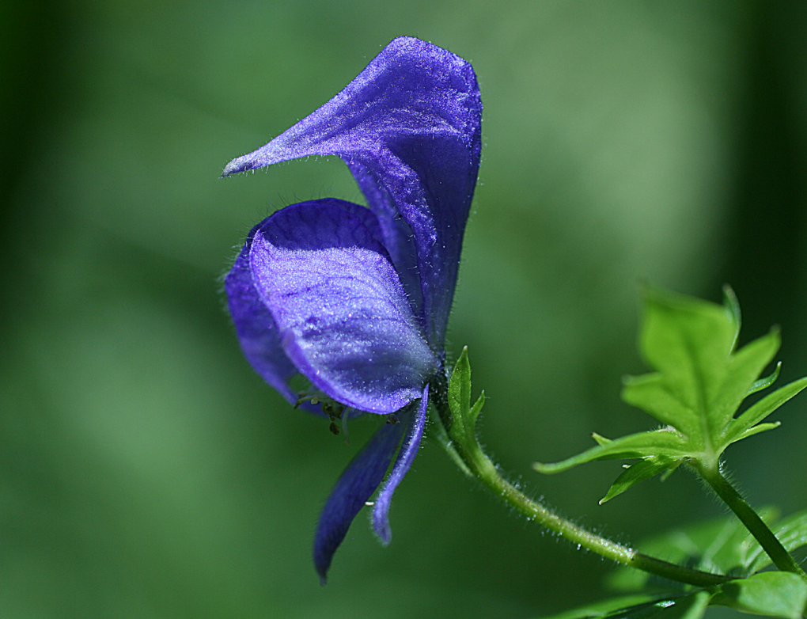
Ranunculales: Ranunculaceae
Aconitum columbianum
Aconitum columbianum

Slide 22
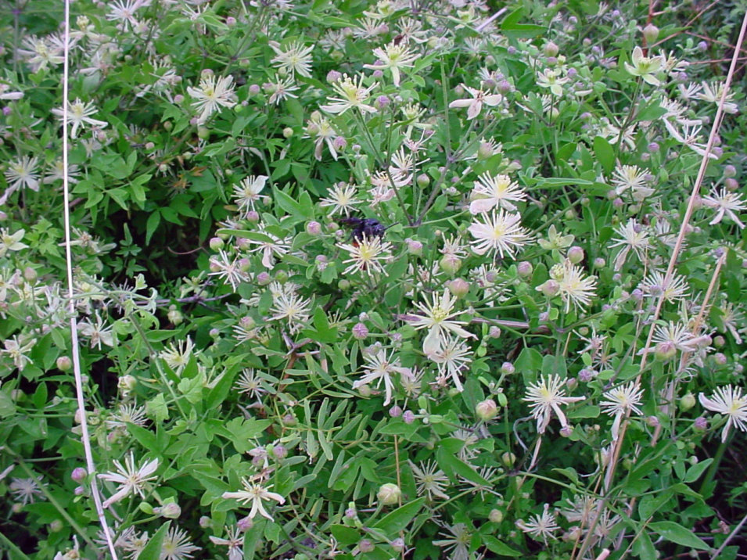
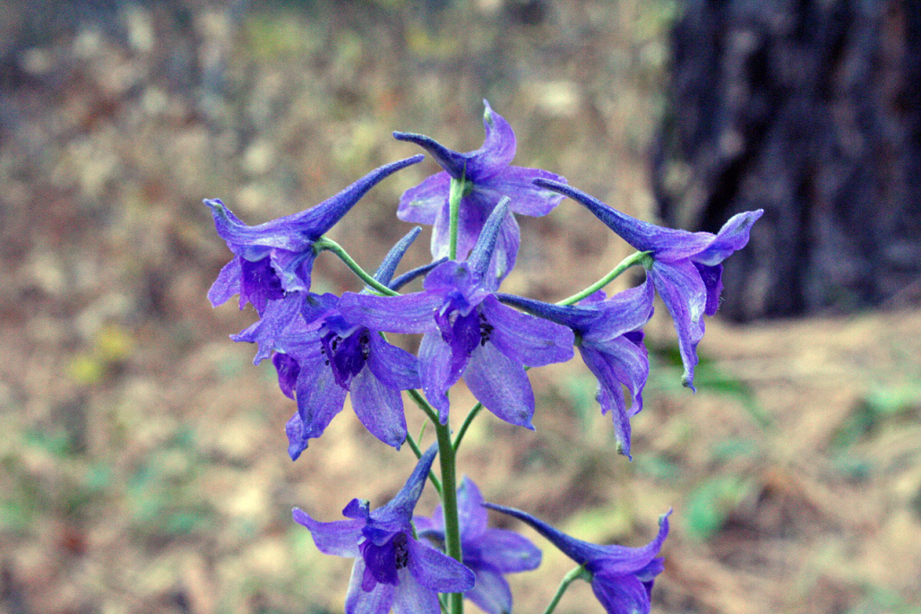
Ranunculales: Ranunculaceae
Delphinium scopulorum
Clematis ligusticifolia

Slide 23
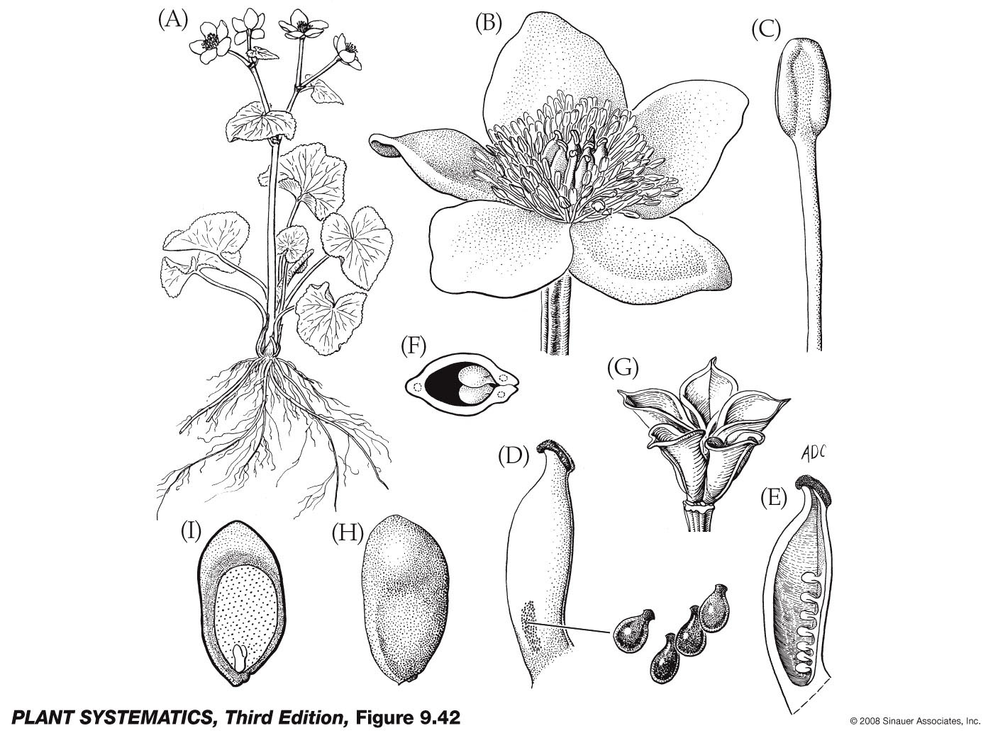

Slide 24
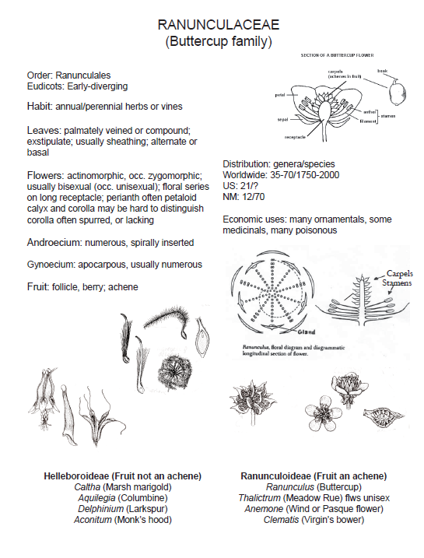

Slide 25
Ranunculales: Ranunculaeae: Ranunculus
variable (simple or compound, but usually pinnate or palmate venation)
Foliage–
Calyx–
Corolla–
Androecium--
Gynoecium–
Fruit–
usually 5 sepals
usually 5 petals
stamens numerous with distinct filaments
carpels distinct, superior ovary
achene (berry or follicle in other genera)

Slide 26
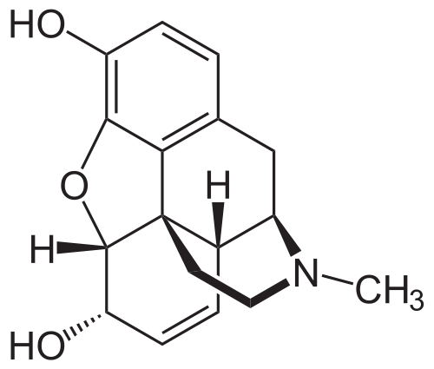
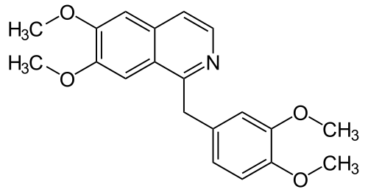
Ranunculales: Papaveraceae contain various alkaloids (secondary metabolite made from amino acids)
Papaverine– smooth muscle dilator given intravenously to relieve vascular spasm
Papaver somniferum is source of opium and its derivatives morphine, heroin, codeine, etc.
Morphine (starting with tyrosine)
Papaverine

Slide 27
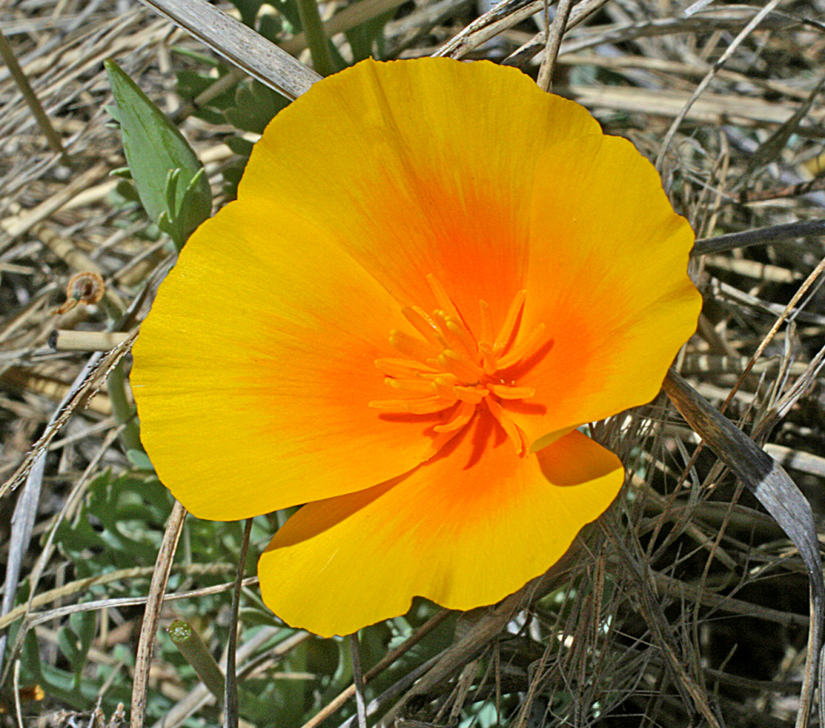
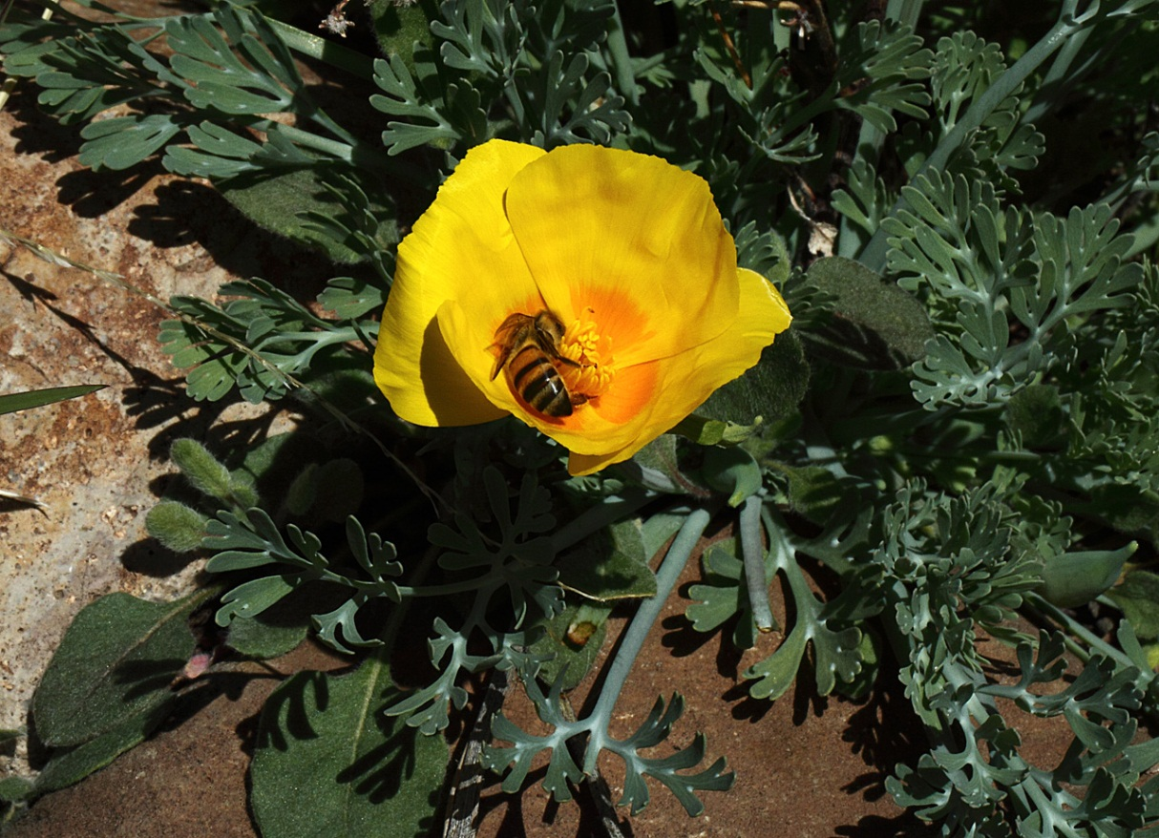
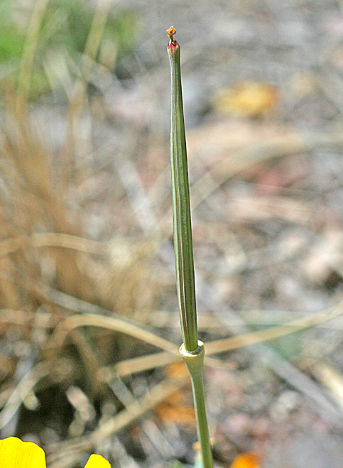
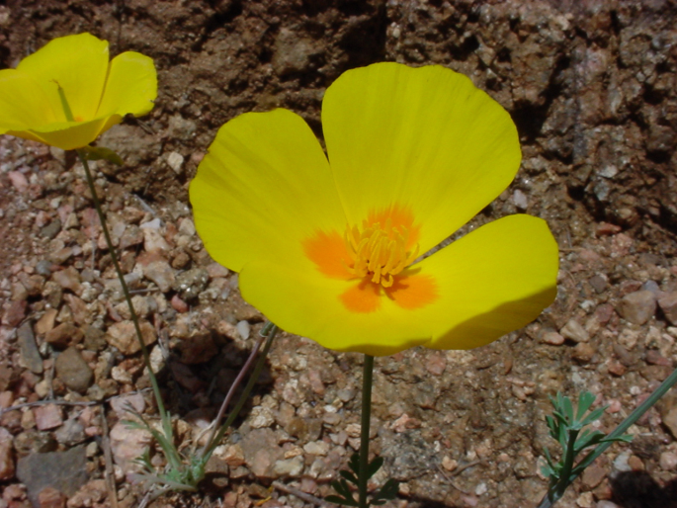
Ranunculales: Papaveraceae: Eschscholzia californica ssp. mexicana
petals
Dissected leaves
4 petals, numerous stamens
Superior ovary, fruit a capsule

Slide 28
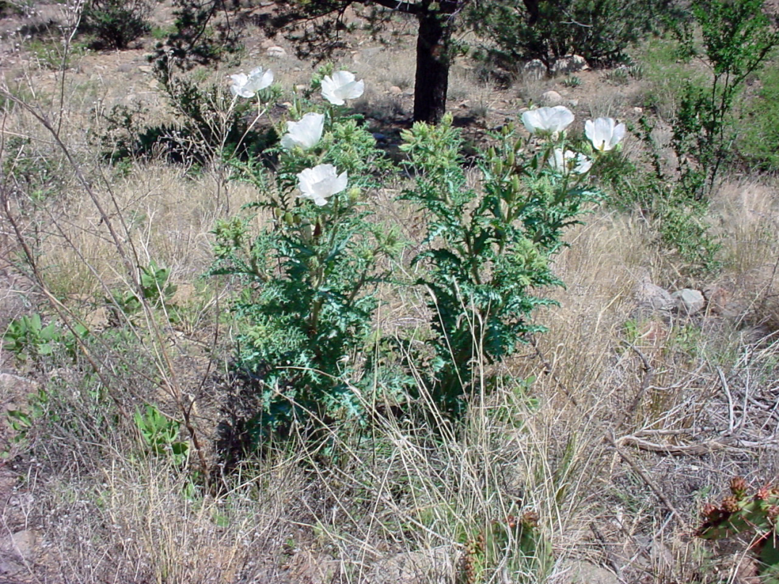
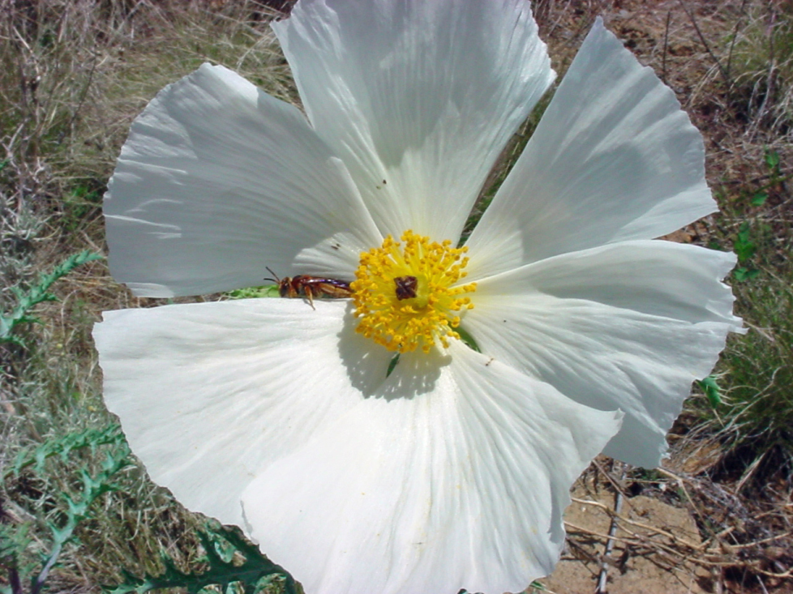
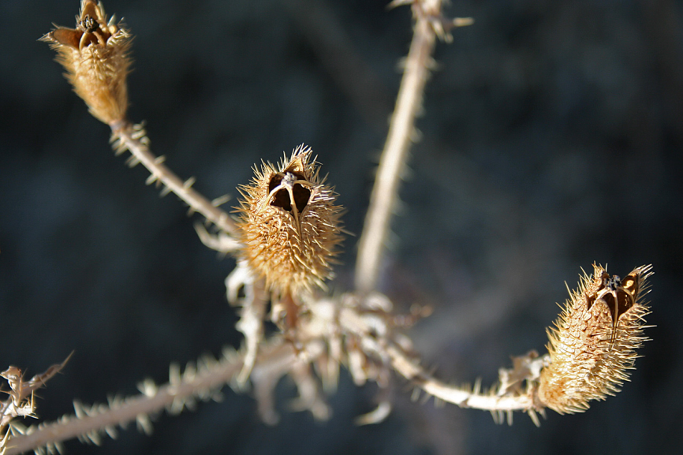
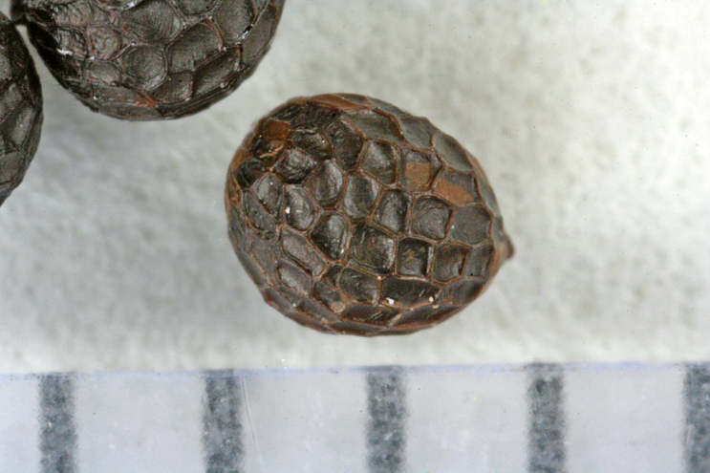
Ranunculales: Papaveraceae: Argemone pleiacantha
6 petals
Dissected leaves
Valvate capsule
Seeds +/- arillate

Slide 30
Ranunculales: Papaveraceae: Argemone pleiacantha
Foliage–
Calyx–
Corolla–
Androecium–
Gynoecium–
Fruit–
lobed/dissected
2 quickly deciduous sepals (caducous)
6 petals
many stamens
superior ovary, 4-6 connate carpels (syncarpous gynoecium)
Septicidal (valvate) capsule

Slide 31
Ranunculales: Berberidaceae
Berberis haematocarpa
Berberis repens
Fruit a berry
Anthers opening by two flaps

Slide 32
Ranunculales: Berberidaceae: Berberis repens
Foliage–
Calyx—
Corolla—
Androecium—
Gynoecium—
Fruit—
Leaves spinose-serrate
6 distinct
6 outer petals and 6 inner petals that are probably really petal-like staminodes (staminode= sterile stamen)
6; anthers opening by flaps that open from the base
Superior ovary, one carpel, capitate stigma
Berry

Slide 33
Santalales
Caryophyllales
Superasterids

Slide 34
Proteales: Proteaceae: Protea
Protea neriifolia

Slide 35
Proteales: Platanaceae: Platanus wrightii
Male flowerheads
Female flowerheads

Slide 36
It’s a great manual, everybody makes a goof now and then.
NO!!!!

Slide 37
Proteales: Platanaceae: Platanus
Foliage–
Calyx–
Corolla—
Androecium–
Gynoecium–
Fruit–
Trees, lobed leaves, toothed
Flowerheads unisexual, flowers very reduced, in globose heads, 3-7 minute petals and sepals
stamens 3-7
superior ovary
multiple of achenes

